Slide 1


Fairness Guarantees in MultiClass Classification with Demographic Parity
Tutti i diritti relativi al presente materiale didattico ed al suo contenuto sono riservati a Sapienza e ai suoi autori (o docenti che lo hanno prodotto). È consentito l'uso personale dello stesso da parte dello studente a fini di studio. Ne è vietata nel modo più assoluto la diffusione, duplicazione, cessione, trasmissione, distribuzione a terzi o al pubblico pena le sanzioni applicabili per legge

Slide 2
Client Selection with Rademacher Complexity
Client selection framework to use on top of other methodologies (e.g. FedAvg)
We cluster the clients based on the updated weights
For each client, we estimate its Rademacher complexity
This quantity depends on two factors: the model, and the data.
It measures how likely is the model to overfit the data. A high score means that the model is too powerful with respect to the data, and it can overfit it easily.

Slide 3
Experiments’ setup
100 clients
Dirichlet partitioning of MNIST, with alpha 0.5
Testing on centralized test set
A shallow model of 128 neurons
A deep model of 8 layers and 32 neurons each
Selection considers 10 clusters on 100 clients
The selection is evaluated against normal FedAvg which selects every time all the 100 clients
K is the number of clusters we choose from the ranked selection (can be top 1, 2, 3 etc..)

Slide 4
Experiments’ setup
Clustering happens on round 5 and on the following rounds the selection is applied to get the top 5 clusters (K=5)
Top 5 because we need to choose enough clients to avoid overfitting and expose the model to enough data (even top 3 can result in a very small selection)
The selection is used in the following rounds to train the model
VARIANTS: reclustering at every round, interleaving between FedAvg and WLRC selection (1 round selection, 1 round fedavg or 1 round selection and 2 rounds fedavg and so on…)
VARIANTS 2: what if K was increased or decreased with time? We define a schedule that restricts/expands the selection over time (every 10 rounds, every 5, etc…) when reclustering.

Slide 5
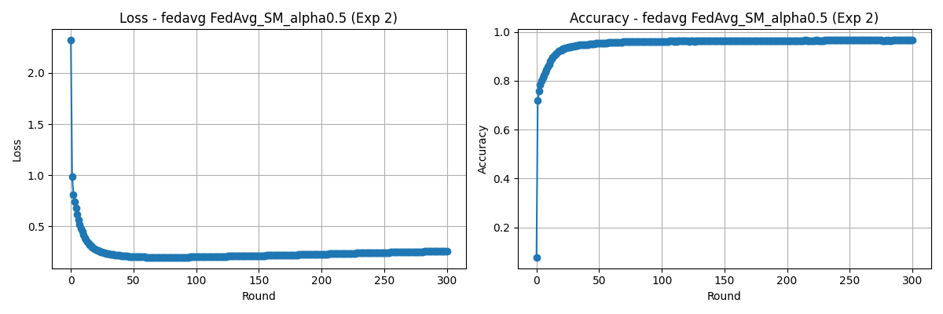
Problems with the shallow model
The initial tests were done with the shallow model, but they didn’t yield very informative results and had very little performance differences
The model learns and overfits too quickly!

Slide 6
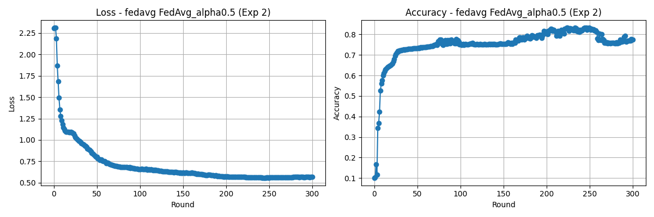
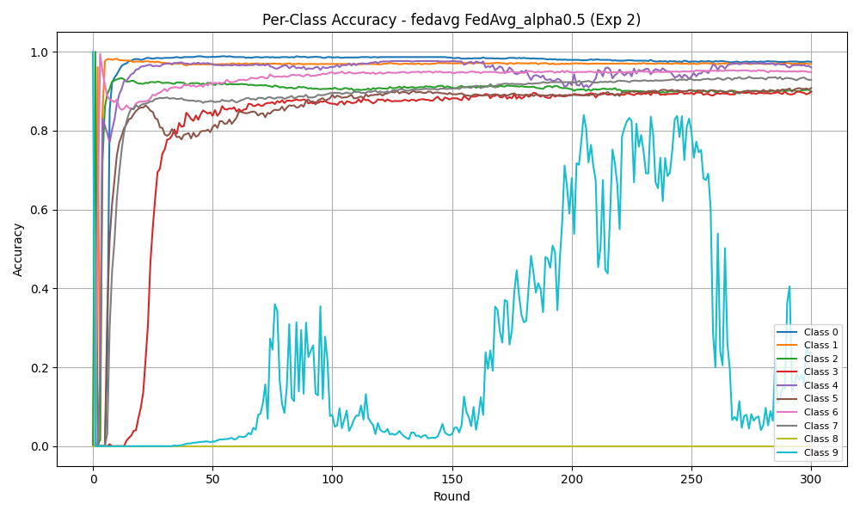
The DeepNet on FedAvg
The effects of nonIIDness are much more obvious here, as the model slowly and does not overfit
There is little
representation of
8s and 9s. The model
struggles to learn them.

Slide 7
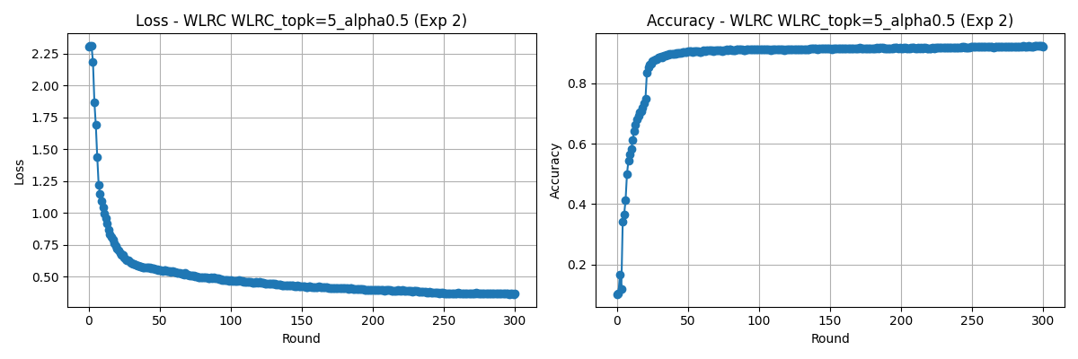
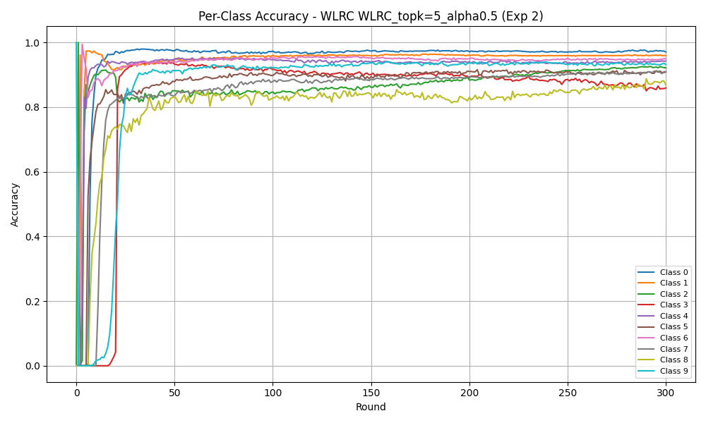
The DeepNet on WLRC selection
The selection helps the model to learn 8 and 9, reaching above 92% accuracy!
Original WLRC
selection

Slide 8
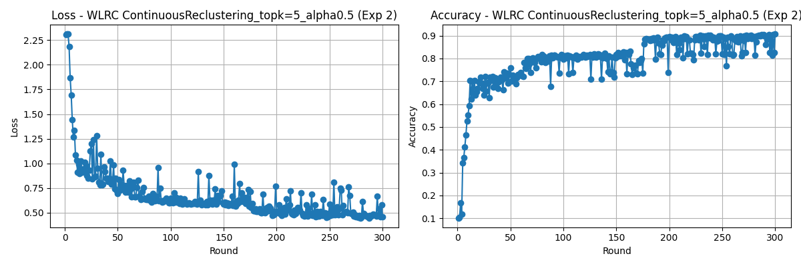
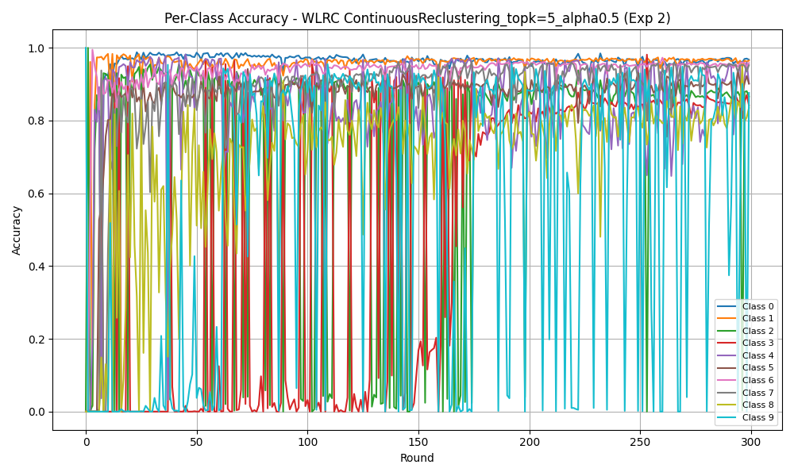
The DeepNet WLRC Variants
The do not work as well, as they are stunted by instability
Reclustering at every
round

Slide 9
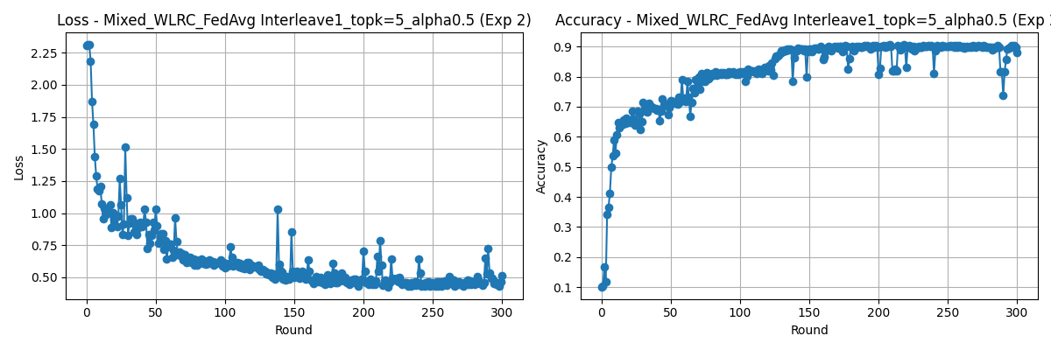
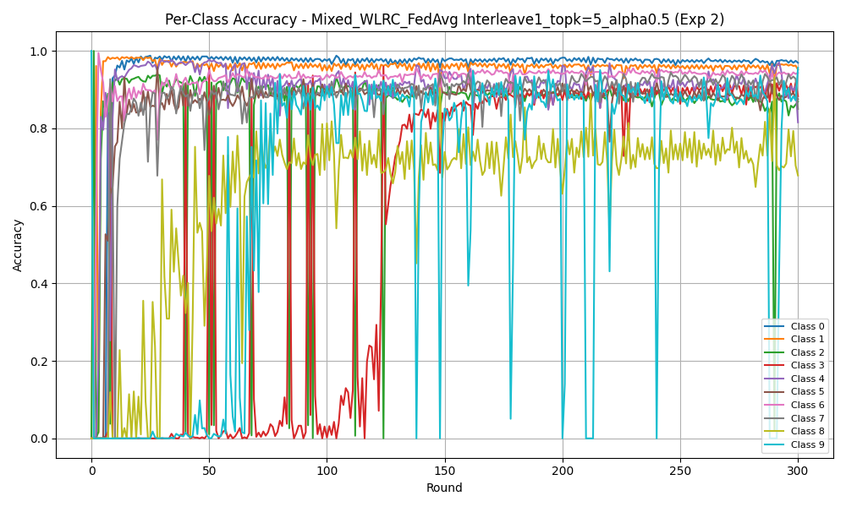
The DeepNet WLRC Variants
Interleaving between
FedAvg and WLRC

Slide 10
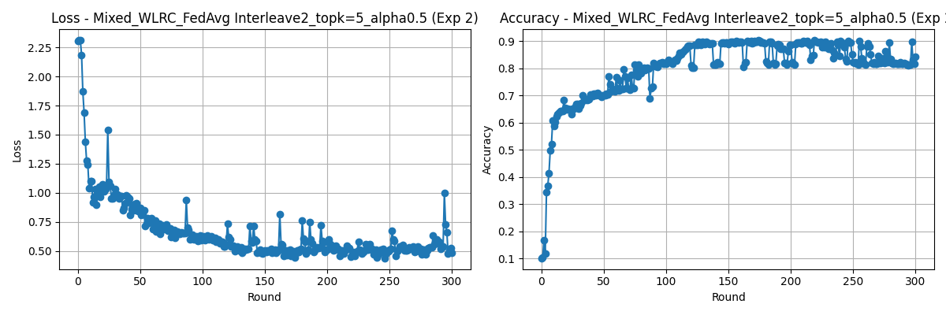
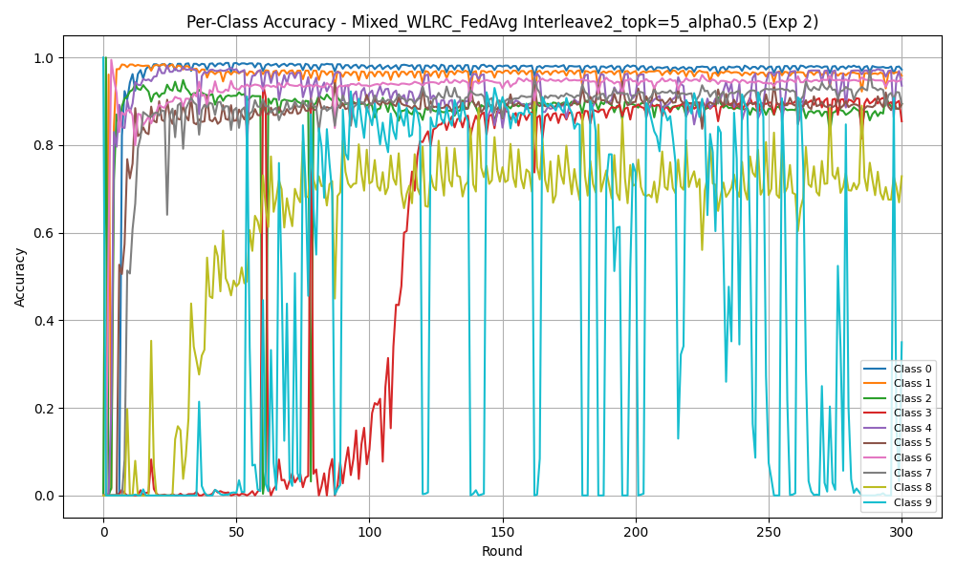
The DeepNet WLRC Variants
Interleaving of two
rounds between
FedAvg and WLRC

Slide 11
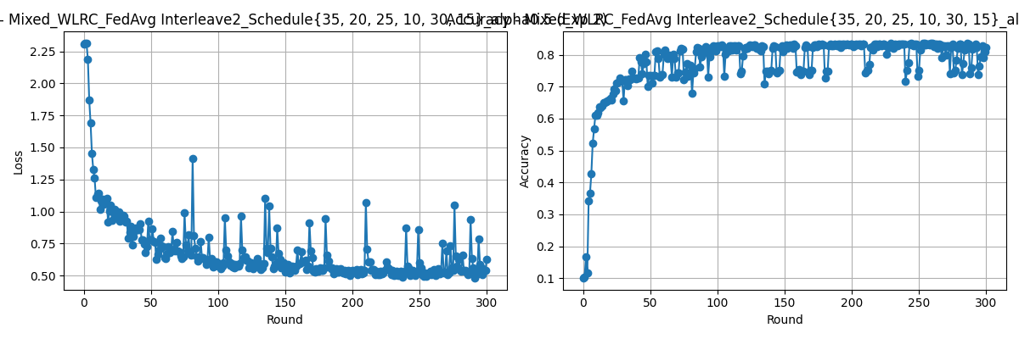
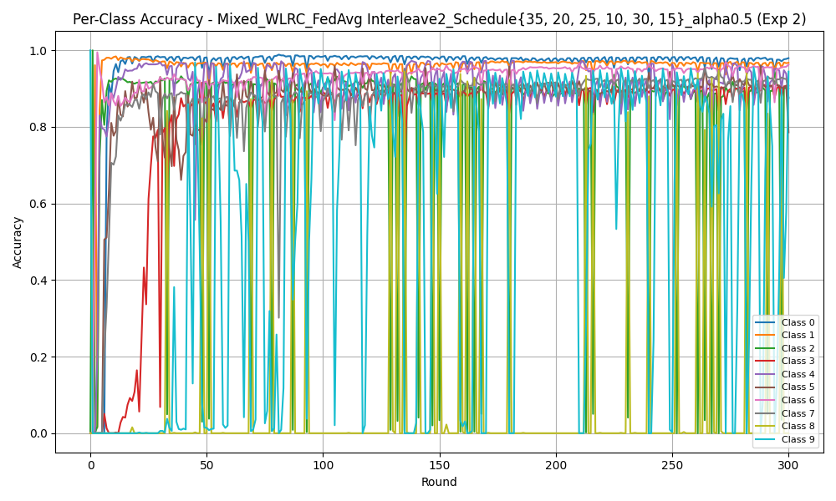
The DeepNet WLRC Variants
Interleaving of two
rounds between
FedAvg and WLRC
with decreasing
K (9 to 3)

Slide 12
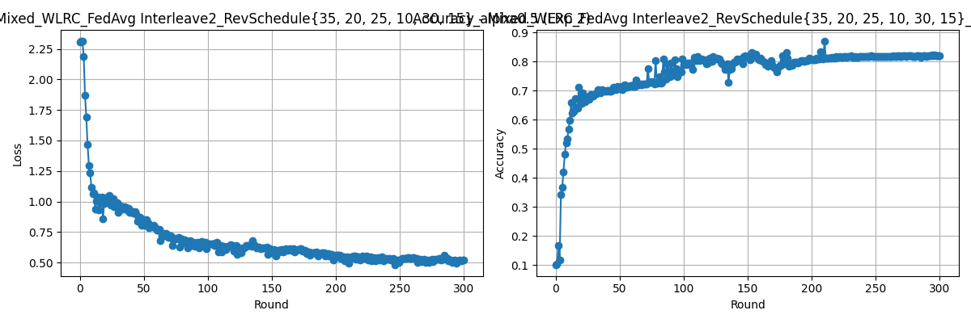
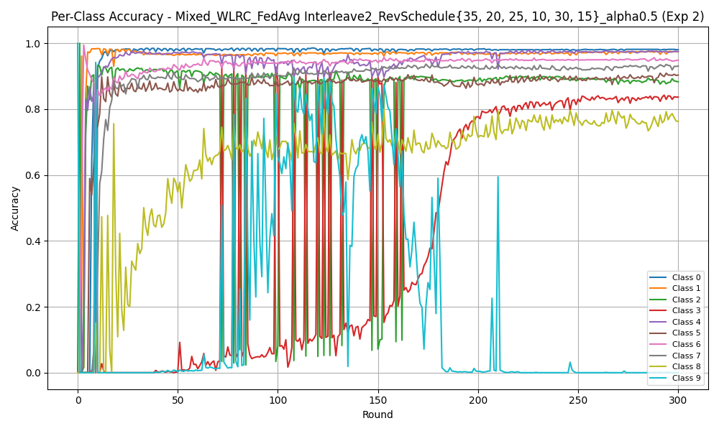
The DeepNet WLRC Variants
Interleaving of two
rounds between
FedAvg and WLRC
with increasing
K (3 to 9)

Slide 13
Conclusions
We have demonstrated that the selection can help, especially if the model cannot learn properly
At the worst, the selection performs roundabout the same as FedAvg
The variants do not work properly, as they are too unstable (the dataset is changed every time)
Thumb rule for choosing number of warmup rounds: the model should at least be at an accuracy above that of a random classifier to start the selection
K should be chosen to ensure enough clients are chosen overall

